Slide 1
EES203: Geochemistry
Instructor: Anoop Ambili
Email id: anoop@iisermohali.ac.in

Slide 2
Geo-chemistry
Introduction of Geochemistry
Geochemistry is the science that uses the tools and principles of chemistry to explain the mechanisms behind major geological systems such as the Earth's crust and its oceans.
The realm of geochemistry extends beyond the Earth, encompassing the entire Solar System, and has made important contributions to the understanding of a number of processes including mantle convection, the formation of planets and the origins of granite and basalt.

Slide 3
Introduction of Geochemistry
The field of geochemistry involves
Chemical Composition of Earth and Planets
Chemical Reactions in Natural Systems Elemental Cycles and Transport Mechanisms

Slide 4
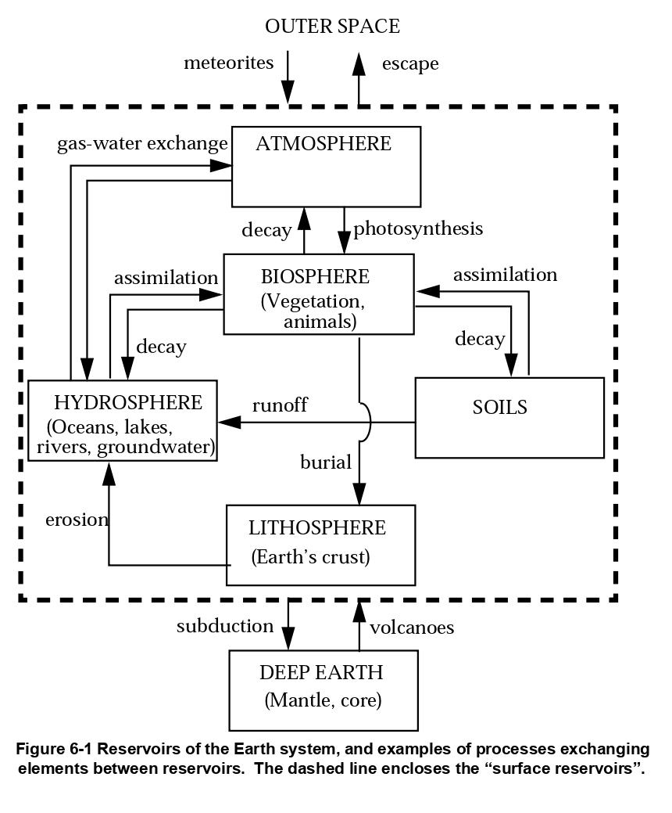
Introduction of Geochemistry

Slide 5
Some questions geochemistry tries to answer include
what elements are present in various soils and rocks in different locations?
What can we learn from those differences?
How are these soils and rocks changing, and how have they changed through the centuries?
How do once-living things like plants and animals decompose after their deaths and what sorts of new things do they form as they interact with the environment (such as fossils or hydrocarbons)?
How do these various processes affect the environment, and how does the environment, weather, and other influences affect them?

Slide 6
Some subsets of geochemistry are:
Isotope geochemistry involves the determination of the relative and absolute concentrations of the elements and their isotopes in the Earth and on Earth's surface.
Cosmo chemistry: Analysis of the distribution of elements and their isotopes in the cosmos.
Aqueous geochemistry studies the role of various elements in watersheds, including copper, sulfur, mercury, and how elemental fluxes are exchanged through atmospheric-terrestrial-aquatic interactions.
Biogeochemistry: Field of study focusing on the effect of life on the chemistry of the earth.
Organic geochemistry: A study of the role of processes and compounds that are derived from living or once-living organisms.
Regional, environmental and exploration geochemistry: Applications to environmental, hydrological and mineral exploration studies.

Slide 7
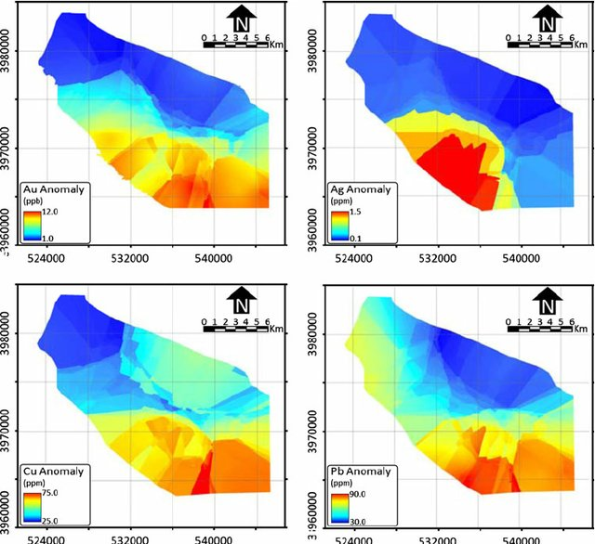
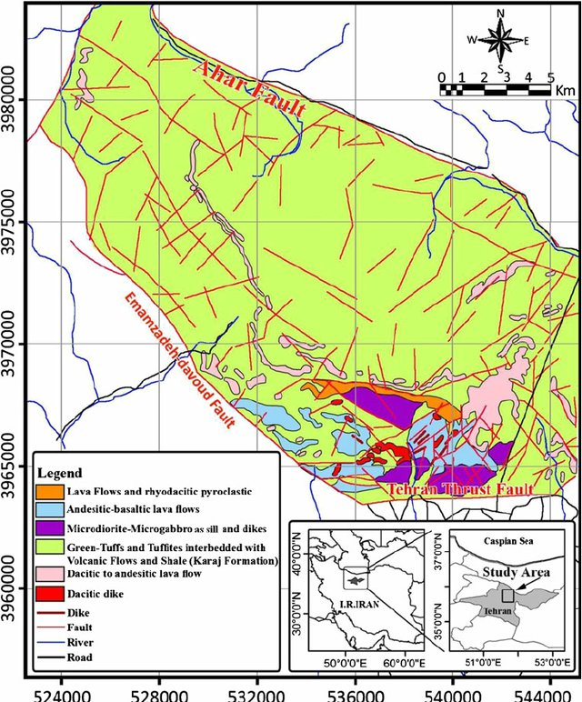
Application of Geochemistry
Central Alborz, Iran

Slide 8
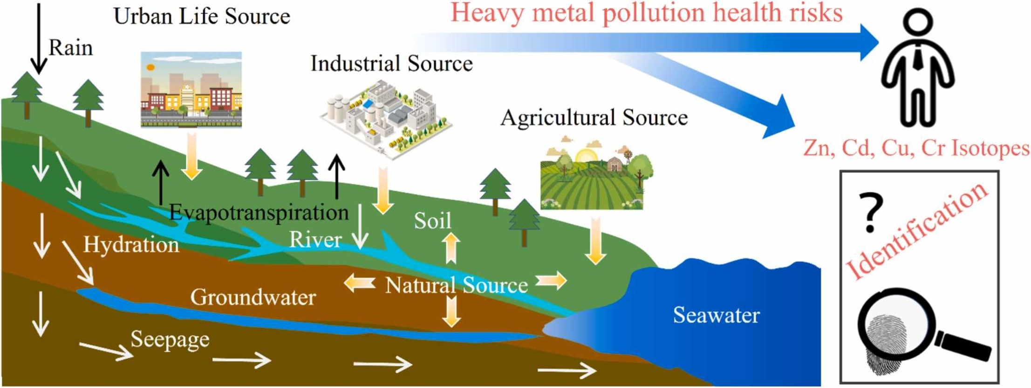
Application of Geochemistry
Source: Wang et al., 2023

Slide 9
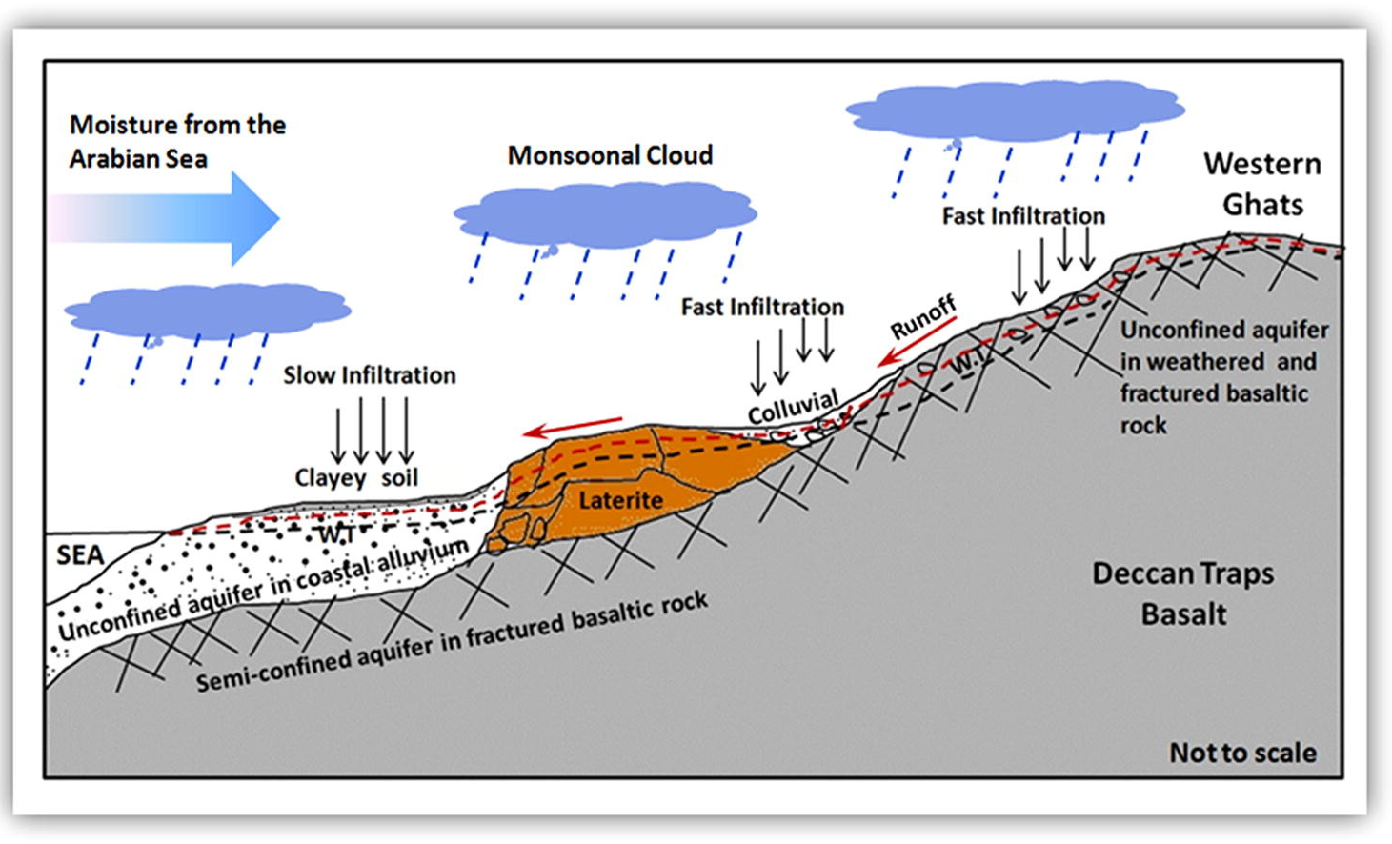
Application of Geochemistry

Slide 10
History of Geochemistry
The term geochemistry was first used by the Swiss-German chemist Christian Friedrich Schönbein in 1838: "a comparative geochemistry ought to be launched, before geochemistry can become geology, and before the mystery of the genesis of our planets and their inorganic matter may be revealed. "However, for the rest of the century the more common term was "chemical geology", and there was little contact between geologists and chemists.
Geochemistry emerged as a separate discipline after major laboratories were established, starting with the United States Geological Survey (USGS) in 1884, and began systematic surveys of the chemistry of rocks and minerals.

Slide 11
History of Geochemistry
The composition of meteorites was investigated and compared to terrestrial rocks as early as 1850. In 1901, Oliver C. Farrington hypothesised that, although there were differences, the relative abundances should still be the same. This was the beginnings of the field of cosmochemistry and has contributed much of what we know about the formation of the Earth and the Solar System.
In the early 20th century, Max von Laue and William L. Bragg showed that X-ray scattering could be used to determine the structures of crystals. In the 1920s and 1930s, Victor Goldschmidt and associates at the University of Oslo applied these methods to many common minerals and formulated a set of rules for how elements are grouped. Goldschmidt published this work in the series Geochemische Verteilungsgesetze der Elemente [Geochemical Laws of the Distribution of Elements].

Slide 12
History of Geochemistry
Clark, who was a chief chemist of the US. Geological Survey from 1884 to 1925, has contributed very much to the science "geochemistry".
The modern science of geochemistry can be dated back to Clark who published a very large number of chemical analyses of the various rocks in the earth's crust.
He computed averages for each common rock type and studied the mutual abundance and distribution of many major and minor elements
He noted that the elements generally decrease in abundance as their atomic weights increase, and summarized the work on elemental abundance in The Data of Geochemistry.

Slide 13
History of Geochemistry
Goldschmidt (1888 - 1947) contributed significantly to the roles of ionic size, coordination and atomic substitution in crystal lattices. He gave a practical definition for the science geochemistry, as it deals with:
1) the abundance of elements in rock, mineral or crystal,
2) the distribution of the elements, and
3) laws governing the abundance and distribution of elements in rock, mineral or crystal.

Slide 14
In the classification scheme of Goldschmidt, elements are divided according to how they partition between coexisting silicate liquid, sulfide liquid, metallic liquid, and gas phase…defined by examining ore smelting slags and meteorites
• Melting a chondrite gives 3 immiscible liquids plus vapor:
Gas Phase
Atmophile
H, He, N, Noble gases
Alkalis, Alkaline Earths, Halogens, B, O, Al, Si, Sc, Ti, V, Cr, Mn, Y, Zr, Nb, Lanthanides, Hf, Ta, Th, U
Silicate Liquid
Lithophile
Sulfide Liquid
Chalcophile
Cu, Zn, Ga, Ag, Cd, In, Hg, Tl, As, S, Sb, Se, Pb, Bi, Te
Metallic Liquid
Siderophile
Fe, Co, Ni, Ru, Rh, Pd, Os, Ir, Pt, Mo, Re, Au, C, P, Ge, Sn

Slide 15
Units of measurement in geochemistry
In geochemistry, units of measurement include parts per million (ppm) and parts per billion (ppb):
Trace levels
Usually expressed in ppm or ppb, these are the concentrations of elements in a material that are below 0.1%.
Percentage oxides
These units are used to measure the concentrations of major and minor elements, such as SiO2, TiO2, Al2O3, Fe2O3, MnO, MgO, CaO, Na2O, K2O, and P2O5.

Slide 16
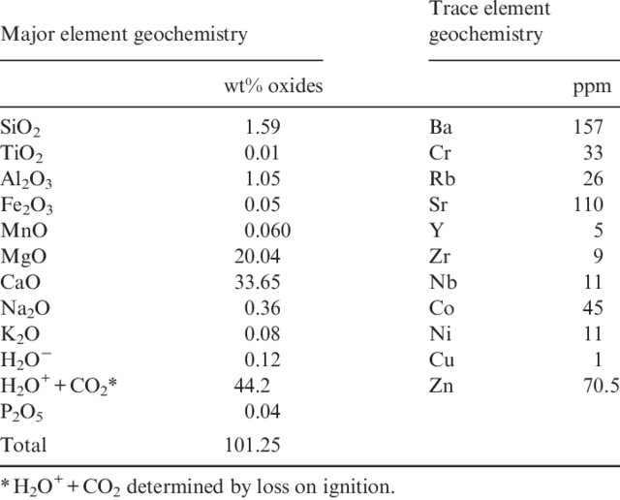
Units of measurement in geochemistry

Slide 17
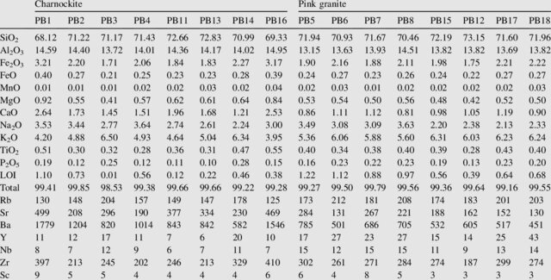
Major and trace elements

Slide 18
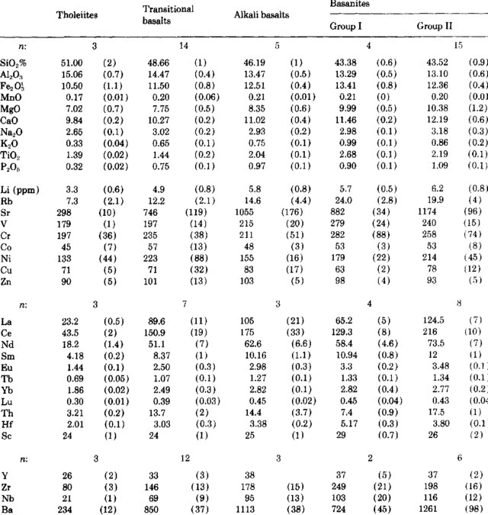
Major and trace elements

Slide 19
Elemental Composition: Quantification of the various elements, both major (e.g., Si, Fe, Ca) and trace (e.g., Cd, Pb, Zn), present in environmental matrices. This is crucial for determining natural and anthropogenic inputs into ecosystems. Mineral Composition: Identifies and quantifies minerals in rocks, soils, and sediments. Understanding mineralogical composition helps in tracing geochemical processes and weathering history.
Isotope Ratios: Used for age dating (e.g., radiocarbon dating) and tracing sources of materials or pollutants (e.g., distinguishing between sources of carbon in environmental samples). pH: Measures the acidity or alkalinity of an environment, affecting many biological and chemical processes. It is essential in soil, water, and sediment quality assessments.
Geochemical variables

Slide 20
Geochemical variables
Redox Potential (Eh): Indicates the oxidative or reductive state of a system, influencing the mobility of elements, including pollutants and nutrients. Important in groundwater and soil studies.
Total Organic Carbon (TOC): Total amount of carbon in organic form within a system, often used as a measure of organic matter content and environmental health.
Nutrient Levels: Concentrations of nutrients like nitrogen (N), phosphorus (P), and sulfur (S), which are key to understanding ecosystem productivity and health, as well as nutrient pollution.
Saturation Indices: Indicates the tendency of a mineral to precipitate or dissolve in a given environment. This is important for understanding mineral deposition or the dissolution of minerals in water bodies.

